Slide 1
PREDICTING DIABETIC PATIENT READMISSION USING MACHINE LEARNING
By:
Kevin Shah
Jigar Panchal

Slide 2
INTRODUCTION
A hospital readmission is when a patient who is discharged from the hospital, gets re-admitted again within a certain period of time
Hospital readmission rates are considered as an indicator of hospital quality
In 2011, American hospitals spent over $41 billion on diabetic patients who got readmitted within 30 days of discharge

Slide 3
DATASET
AIM: To predict the number of readmissions of diabetic patients in less then 30 days
Publicly available dataset from UCI repository
It consists data for 130 US hospitals (1999-2008) containing 101,766 observations over 10 years
It has over 50 features including patient characteristics, conditions, test and 23 medications
This is binary classification problem. The target variable “Readmitted” has 2 classes: Output=0: No readmission or Readmission after 30 days Output=1: Readmission in less then 30 days

Slide 4
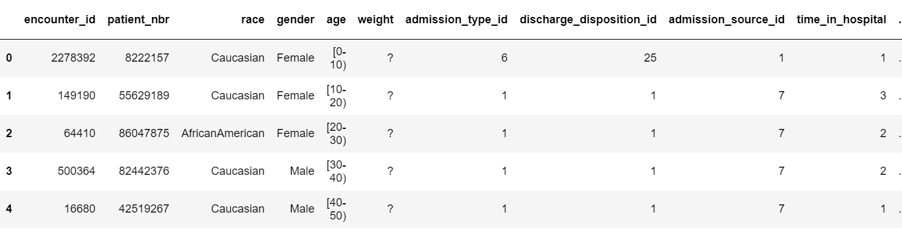
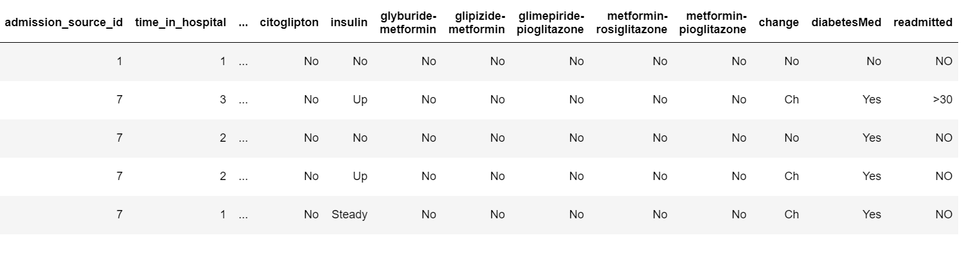
INSIGHTS ABOUT OUR DATASET

Slide 5
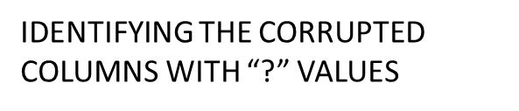
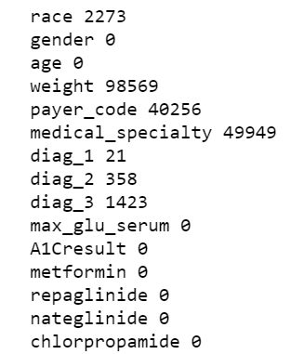
DATA CLEANING
Dropping columns with too many corrupted values: weight: “weight in pounds”
Payer_code: “Integer identifier like Blue Cross/Blue Shield, Medicare, and self-pay”
Medical_specialty: “Specialty of the admitting physician, cardiology, internal medicine, surgeon etc.”
Removed rows where gender was unknown
Removed dead patient as the probability of readmission is zero

Slide 6
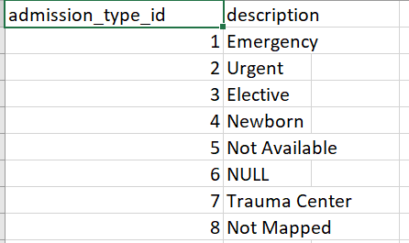
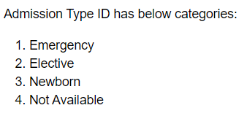
DATA PRE-PROCESSING
Encoding some features that holds the same meaning into fewer categories
Similarly, we did for discharge_deposition_id and admission_source_id

Slide 7
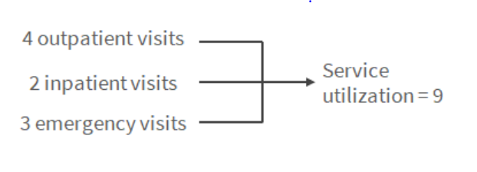

DATA PRE-PROCESSING
Creating patient visit feature that holds the total number of patient visit in different cases:
Patient Visit = 9
“RACE” (0,1,2,3,4)
“GENDER” (0,1)
“AGE” (0,1,2,3,4,5,6,7,8,9)
“MAX_GLU_SERUM”
“A1CRESULT”
“CHANGE” (0,1)
“DIABETESMED” (0,1)

Slide 8
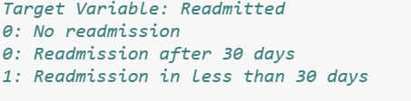
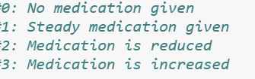
DATA PRE-PROCESSING
Combining the readmission after 30 days and no readmission into a single category:
For all different medications, converting Categorical medicational features to numerical using replace method

Slide 9
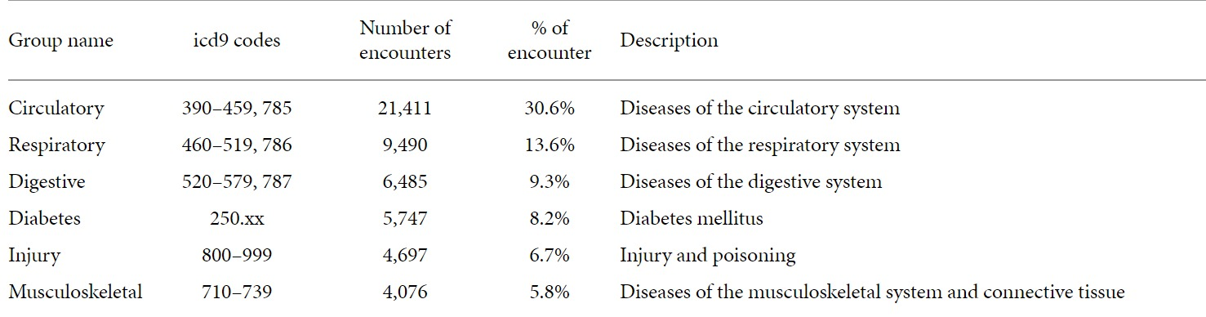
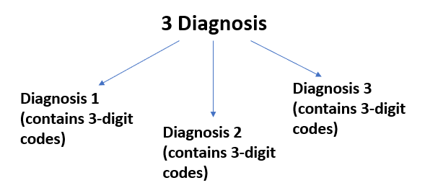
DATA PRE-PROCESSING
Converting diagnosis numerical features into categorical:
Combined all 3-digit codes into 9 disease groups like “Circulatory, Respiratory, Digestive, Diabetes, Injury, Musculoskeletal, Genitourinary, Neoplasms, and Others”

Slide 10
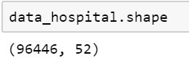
DATA PRE-PROCESSING
Creating additional columns for diagnosis
After pre-processing, we are left with 96,446 rows and 52 columns
Removed unnecessary features and the duplicate values for patient numbers belonging to a single patient

Slide 11
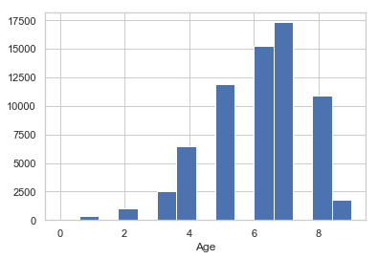
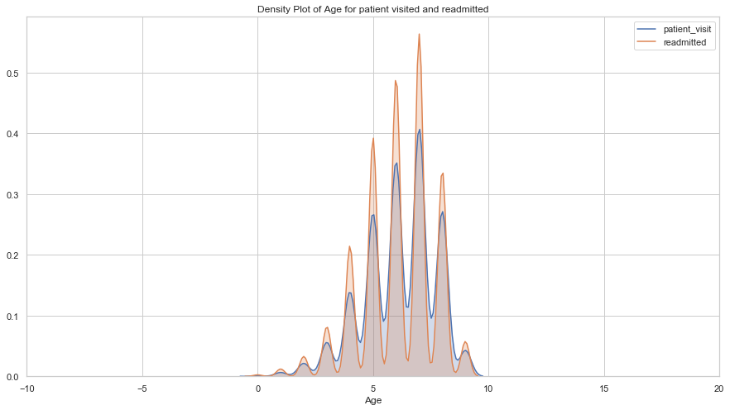
EXPLORATORY DATA ANALYSIS
PATIENT RE-ADMITTED COUNT AS PER AGE
DENSITY PLOT OF AGE FOR PATIENT VISITED AND READMITTED

Slide 12
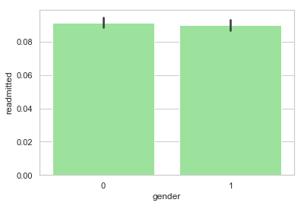
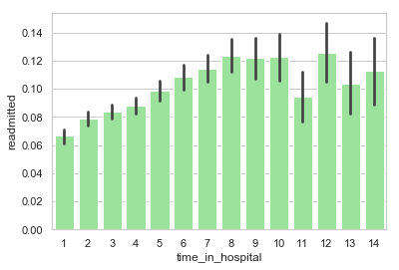
EXPLORATORY DATA ANALYSIS
PATIENT RE-ADMITTED ON BASIS OF GENDER
TIME SPENT IN HOSPITAL OF RE-ADMITTED PATIENT

Slide 13
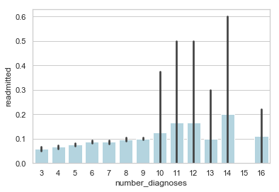
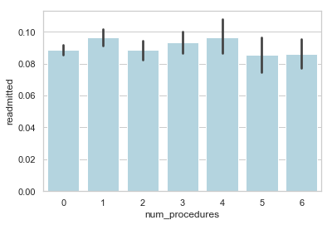
EXPLORATORY DATA ANALYSIS
NUMBER OF DIAGNOSES OF RE-ADMITTED PATIENTS
NUMBER OF PROCEDURES THAT RE-ADMITTED PATIENTS UNDERWENT

Slide 14
DATA PREPARATION
When there is high correlation among predictor variables, it leads to unstable and unreliable estimates.
VIF value demonstrates the possibility of multicollinearity where, 1 means no multicollinearity, 1 - 5 means little multicollinearity > 5 highly multicollinearity
We have removed variables which are highly correlated.

Slide 15
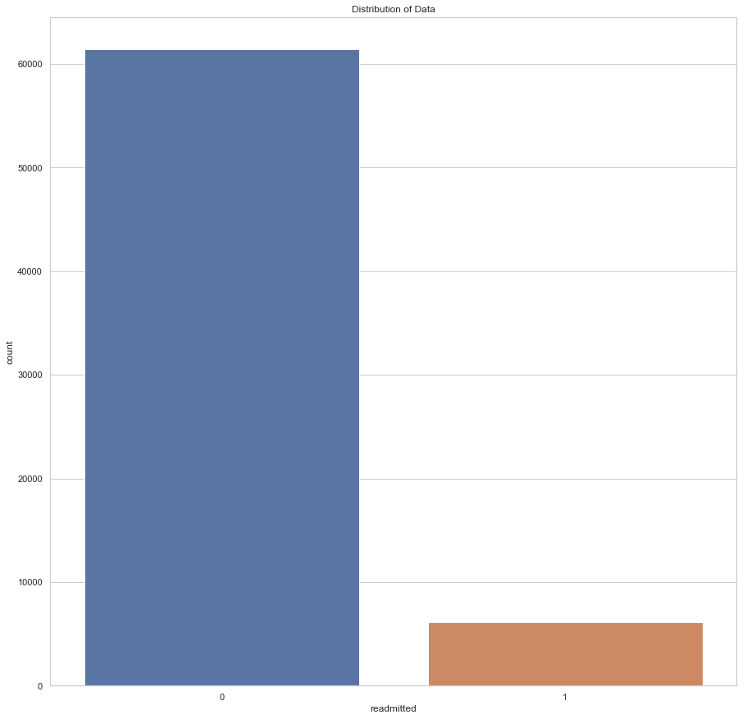
PLOTTING THE DISTRIBUTION OF THE READMITTED PATIENT
The graph shows that the data is not balanced and there is more data of “No readmission category”.
It needs to be balanced in order to avoid biased outcome

Slide 16
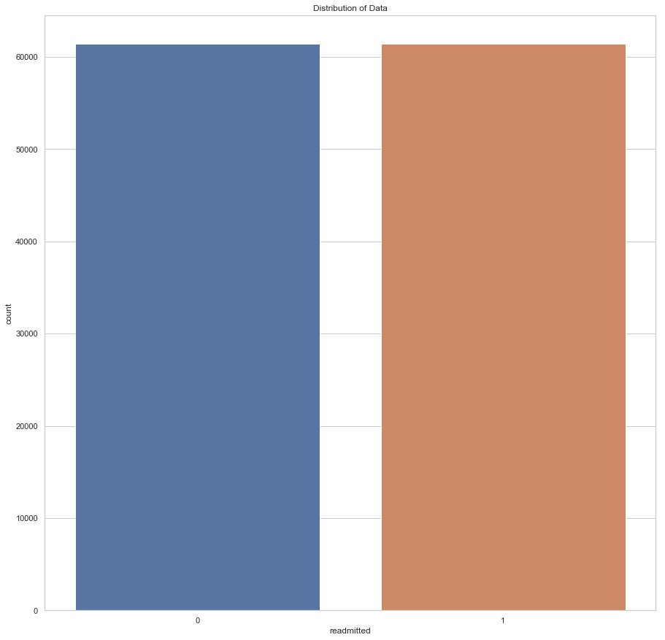
DATA BALANCING
The data is balanced using Smote Method (synthetic minority oversampling technique) in which synthetic samples are generated to randomly sample the data of minority class.
After applying SMOTE method,
the data is now balanced.

Slide 17
PERFORMING MODELING AND THEIR OUTCOME
Six classifications models used:
Logistic Regression
Decision Tree
Random Forest
KNN
Naïve Bayes
Gradient Boosting

Slide 18
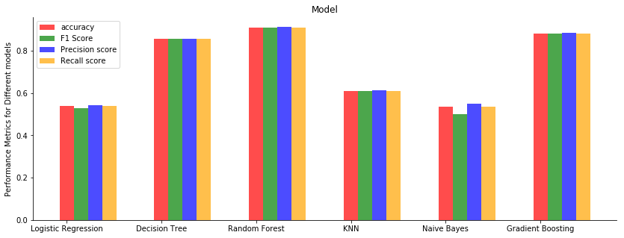
PERFORMING MODELING AND THEIR OUTCOME

Slide 19
PERFORMING MODELING AND THEIR OUTCOME
Random Forest was the best performing model.
Model Used | Accuracy score | Precision score | Recall score | F1 score
Logistic Regression | 53% | 54% | 53% | 52%
Decision Tree | 86% | 86% | 86% | 86%
Random Forest | 91% | 92% | 91% | 91%
KNN | 61% | 61% | 61% | 61%
Naïve Bayes | 54% | 55% | 54% | 51%
Gradient Boosting | 88% | 88% | 88% | 88%

Slide 20
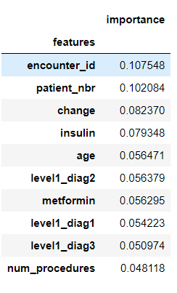
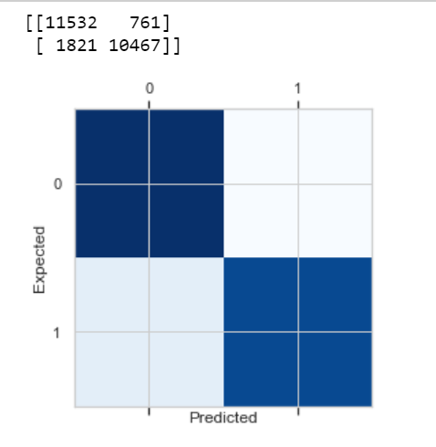
RANDOM FOREST CONFUSION MATRIX AND FEATURE IMPORTANCE
11532
761
1821
10467

Slide 21
CONCLUSION
For a given set of features we now have a pretty accurate model about the chance of possible readmission.
Through important features we are able to predict the possibility of diabetic patient getting readmitted and thus helping hospitals to save millions of dollars and improve patient care quality.
Features like Insulin, Age and Number of Procedures undertaken turn out to be important features in determining whether a patient will we readmitted or not.

Slide 22
THANK YOU

